Slide 1
Chapter 10
  The Tower of Babel

Slide 2
Learning Objectives (1 of 2)
Explain why so many programming languages exist
List four key procedural languages and the main purpose for the development of each
Describe the purpose of each special-purpose language: SQL, HTML, JavaScript, and R
Describe the alternative paradigms for programming languages: functional, logic, and parallel
Notes:
解释为什么存在这么多编程语言
列出四种主要的程序语言以及每种语言的主要开发目的
描述每种特殊语言的目的：SQL，HTML，JavaScript和R
描述编程语言的替代范例：功能，逻辑和并行

Slide 3
Learning Objectives (2 of 2)
Name a functional programming language and a logic programming language
Describe how logic programming languages work, and explain what facts, rules, and inference are
Explain how the MIMD model of parallel processing could be used to find the largest number in a list
Notes:
命名功能性编程语言和逻辑性编程语言
描述逻辑编程语言如何工作，并说明事实，规则和推论是什么
说明如何使用并行处理的MIMD模型查找列表中的最大数目

Slide 4
Why Babel?
Why isn’t there just one high-level programming language?
  Why isn’t there just one model of automobile?
Each language has tasks it performs well
  Complex computations on real numbers
  Detailed page layout
  Database interactions
Choose a language based on the tasks to be done
Choose a language based on its approach to computation (its philosophy)
Notes:
为什么不只有一种高级编程语言？
为什么不只有一种汽车模型？
每种语言都有出色的任务
实数的复杂计算
详细的页面布局
数据库交互
根据要完成的任务选择一种语言
根据计算方法（其哲学）选择一种语言

Slide 5
Procedural Languages (1 of 15)
Procedural language philosophy
  Tell the computer step by step how to manipulate variables (data in memory locations)
Analogy to Romance languages
Here we survey procedural languages by historical perspective and intended purpose
  Plankalkül, Fortran, COBOL, C/C++, Ada, Java, Python, C# and .NET
Notes:
程序语言哲学
逐步告诉计算机如何操作变量（内存位置中的数据）
比喻为浪漫语言
在这里，我们从历史的角度和预期的目的来调查程序语言
Plankalkül，Fortran，COBOL，C / C ++，Ada，Java，Python，C＃和.NET

Slide 6
Procedural Languages (2 of 15)
Plankalkül
  Translation: “formal planning system.”
  Designed in Germany in 1945 by Konrad Zuse
  Never implemented
  Had the sophisticated concepts presented in the manual been known prior to 1972, they may have changed the development of programming languages
Notes:
普兰卡库尔
翻译：“正式的计划系统”。
Konrad Zuse于1945年在德国设计
从未实施
如果在1972年之前就知道了手册中介绍的复杂概念，那么它们可能会改变编程语言的发展

Slide 7
Procedural Languages (3 of 15)
Fortran: Formula Translating System
Developed at IBM in the 1950s by John Backus
First high-level language actually implemented
Focus on numerical computation
Control structures similar to assembly language
GO TO
  Like a JUMP
  Can create spaghetti code
External libraries: tested special-purpose code
  So many libraries exist that coders sometimes don’t need to write much actual code
Notes:
Fortran：公式翻译系统
1950年代由John Backus在IBM开发
实际实施的第一种高级语言
专注于数值计算
控制结构类似于汇编语言
去
就像跳
可以创建意大利面条代码
外部库：经过测试的专用代码
存在如此众多的库，以至于编码人员有时无需编写太多实际代码

Slide 8
Procedural Languages (4 of 15)
COBOL: COmmon Business-Oriented Language
Developed by the U.S. Navy in 1959 and 1960 by a group headed by Admiral Grace Murray Hopper
Focus on business applications
  Inventory or payroll
  Master file updated by transaction files: file I/O key
Wide use in legacy code (old code still in use)
Year 2000 (Y2K) issues
  Required massive updating of old COBOL
Notes:
COBOL：COmmon面向业务的语言
由海军上将格雷斯·默里·霍珀（Grace Murray Hopper）领导的小组在1959年和1960年由美国海军开发
专注于业务应用
库存或工资单
通过事务文件更新主文件：文件I / O密钥
遗留代码中的广泛使用（仍在使用旧代码）
2000年（Y2K）问题
需要大规模更新旧的COBOL

Slide 9
Procedural Languages (5 of 15)
C/C++
C developed in the early 1970s at AT&T Labs by Dennis Ritchie
Focuses on system programming
Close connection to UNIX
Highly efficient
  High-level constructs as desired
  Low-level constructs when efficiency is needed
Notes:
C / C ++
Dennis Ritchie在1970年代初期在AT＆T实验室开发的C语言
专注于系统编程
与UNIX的紧密连接
高效率
所需的高级构造
需要效率时的底层构造

Slide 10
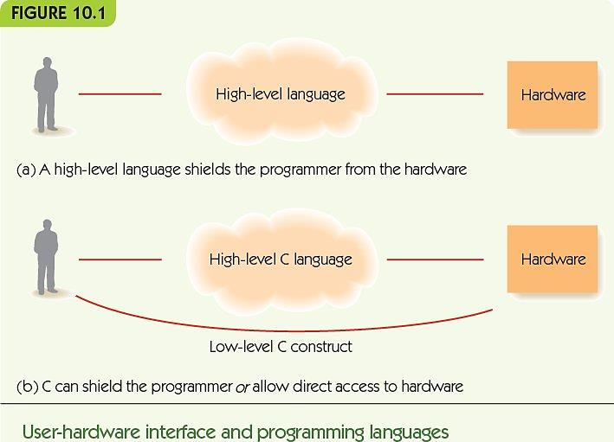
Procedural Languages (6 of 15)

Slide 11
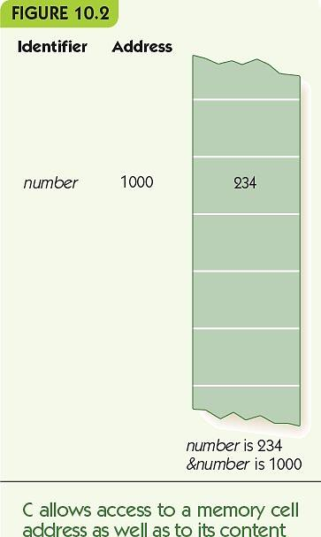
Procedural Languages (7 of 15)
Access to variable’s value and its location
  number refers to its value
  &number refers to its memory location
Pointer data type contains memory locations
Notes:
访问变量的值及其位置
数字是指其价值
＆number表示其内存位置
指针数据类型包含内存位置

Slide 12
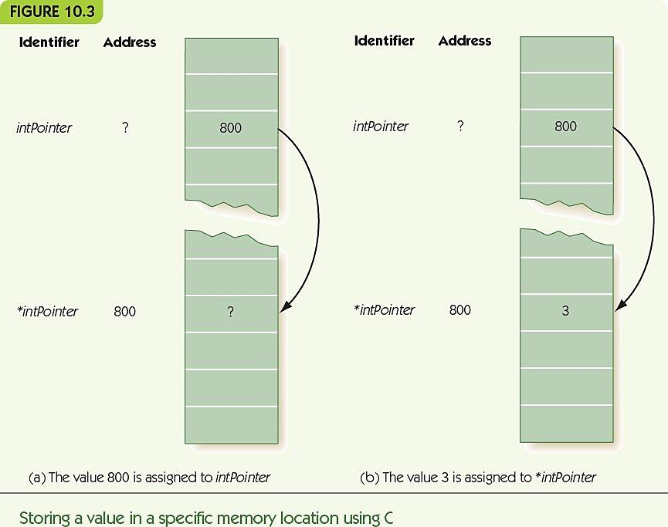
Procedural Languages (8 of 15)

Slide 13
Procedural Languages (9 of 15)
C specialty: system programming
  Example: device drivers
  Ability to interact with low-level hardware
C++ was developed in the early 1980s at AT&T Labs by Bjarne Stroustrup
C++ is a superset of C
Object-oriented programming
Collections of code libraries
Notes:
C专长：系统编程
示例：设备驱动程序
与底层硬件交互的能力
C ++是由Bjarne Stroustrup在1980年代初期在AT＆T实验室开发的
C ++是C的超集
面向对象编程
代码库集合

Slide 14
Procedural Languages (10 of 15)
Ada
Developed in the 1970s for the U.S. military
Specialties
  Multiprocessing
  Strong object-oriented
  Safety and reliability
Used heavily by
  Defense Department
  Transportation industry
  Financial industry
  Communications industry
Notes:
阿达
在1970年代为美国军方开发
专长
多处理
强大的面向对象
安全可靠
被大量使用
国防部
运输业
金融业
通讯行业

Slide 15
Procedural Languages (11 of 15)
JAVA
  Developed by Sun Microsystems Inc. in the early 1990s
  Designed for
    Platform independence
    Reliability
    Security
    Graphical user interfaces
  Strong integration with web browsers
  Object-oriented, like C++
Notes:
爪哇
由Sun Microsystems Inc.在1990年代初期开发
专为
平台独立性
可靠性
安全
图形用户界面
与网络浏览器的强大集成
面向对象，例如C ++

Slide 16
Procedural Languages (12 of 15)
  Java programs may be
    Applications: stand-alone programs
    Applets: small programs that are accessed from the web and executed using Java Web Start
  Portability is a key strength
    Applications and applets run on most platforms and through most browsers
    Source code compiles to platform-independent bytecode (generic low-level code)
    Java bytecode interpreter translates to host machine (small program, integrated into browsers)
Notes:
Java程序可能是
应用程序：独立程序
小程序：可通过Web访问并使用Java Web Start执行的小程序
便携性是关键优势
应用程序和小程序可以在大多数平台和大多数浏览器上运行
源代码编译为平台无关的字节码（通用低级代码）
Java字节码解释器转换为主机（小程序，集成到浏览器中）

Slide 17
Procedural Languages (13 of 15)
Python
  Developed by Guido van Rossum in the early 1990s
  Open source: source code for Python is freely available and anyone may suggest changes
    Language evolution is now guided by the Python Software Foundation
  Developed for system administrator tasks and web interfaces
  Interpreted language: source code is translated to object code when executed
  Relaxed syntax, easy to use, extensive libraries
Notes:
蟒蛇
由Guido van Rossum在1990年代初期开发
开源：Python的源代码可免费获得，任何人都可以提出更改建议
语言进化现在由Python Software Foundation指导
专为系统管理员任务和Web界面而开发
解释语言：执行时将源代码转换为目标代码
轻松的语法，易于使用的扩展库

Slide 18
Procedural Languages (14 of 15)
C#
Developed by Microsoft in 2000
Successor to C++ but not a superset
Similar to Java in form and goals
  Security
  Reliability
Integrated into the .NET framework
  Microsoft support framework for many languages
  Large collection of code libraries and tools
Garbage collection: reclaiming memory for reuse
Notes:
C＃
由Microsoft在2000年开发
C ++的后继者，但不是超集
在形式和目标上类似于Java
安全
可靠性
集成到.NET框架中
Microsoft支持多种语言的框架
大量的代码库和工具
垃圾回收：回收内存以进行重用

Slide 19
Procedural Languages (15 of 15)
.NET
All .NET languages are compiled into Microsoft Intermediate Language (MSIL)
MSIL code is compiled by a just-in-time (JIT) compiler, small program that produces platform-specific object code
.NET languages include Ada, COBOL, C++, C#, and Visual Basic .NET
Notes:
。净
所有.NET语言都被编译为Microsoft中间语言（MSIL）
MSIL代码由即时（JIT）编译器编译，该小型程序生成特定于平台的目标代码
.NET语言包括Ada，COBOL，C ++，C＃和Visual Basic .NET

Slide 20
Special-Purpose Languages (1 of 10)
Languages designed for one specific purpose, not general-purpose programming languages
SQL, Structured Query Language
  Ask questions about data in a database
HTML (HyperText Markup Language)
  Describes the formatting of webpages
JavaScript
  Lightweight scripting language for active webpages
  Code is embedded in the HTML for the page
R
  Specialized language designed for statistics and graphics
Notes:
专为一种特定目的而设计的语言，而不是通用编程语言
SQL，结构化查询语言
询问有关数据库中数据的问题
HTML（超文本标记语言）
描述网页的格式
JavaScript
用于活动网页的轻量级脚本语言
代码嵌入在页面的HTML中
R
专为统计和图形设计的专业语言

Slide 21
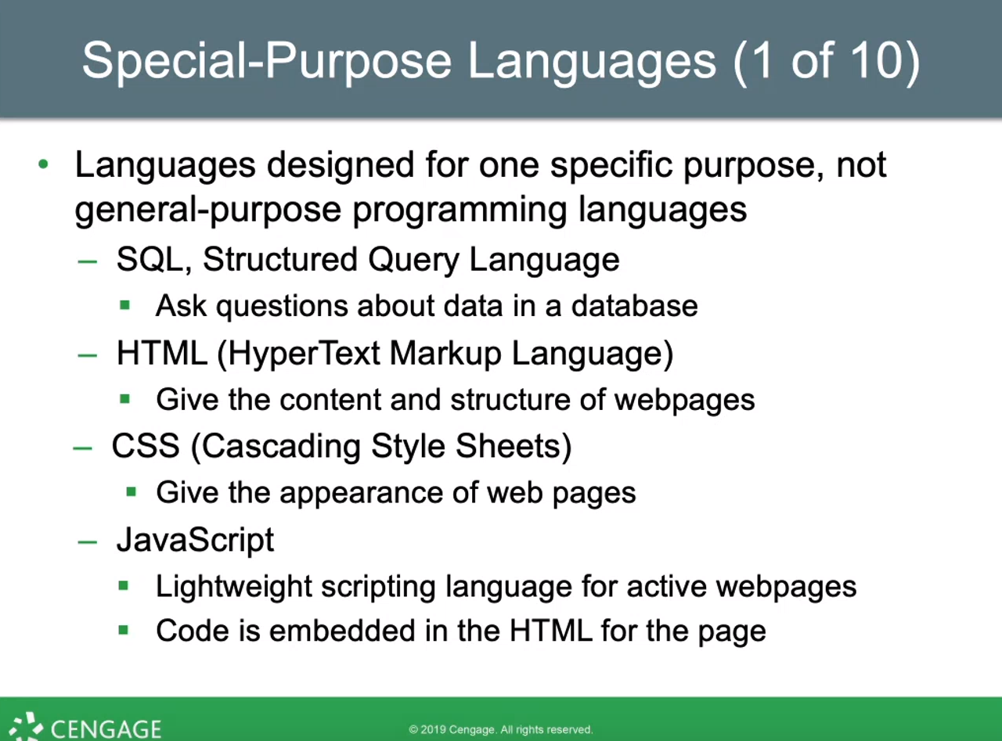
外观/外貌

Slide 22
Special-Purpose Languages (2 of 10)
SQL
Developed by IBM in 1986
Databases store data
A query describes what information the user wants, not how to find it
Example: Find all names of vendors with whom we do more than $40,000 worth of business
  SELECT NAME
  FROM VENDOR
  WHERE PURCHASE > 40000
Notes:
的SQL
由IBM在1986年开发
数据库存储数据
查询描述用户想要什么信息，而不是如何找到它
示例：查找与我们开展的业务总价值超过40,000美元的供应商的所有名称
选择名称
来自供应商
在哪里购买> 40000

Slide 23
Special-Purpose Languages (3 of 10)
HTML
Contains text to be displayed and tags
Tags describe
  Formatting of text
  Special effects
  Links to other webpages
Tags come in pairs: begin and end
Tags are written within angle brackets
  <title> and </title>
  <em> and </em>
Notes:
的HTML
包含要显示的文本和标签
标签描述
文字格式
特殊效果
链接到其他网页
标签成对出现：开始和结束
标签写在尖括号内
<title>和</ title>
<em>和</ em>

Slide 24
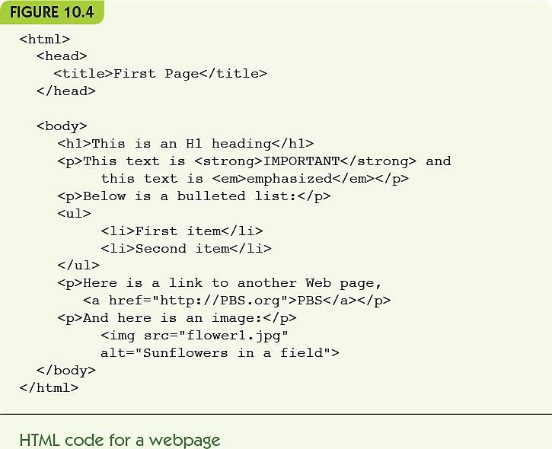
Special-Purpose Languages (4 of 10)

Slide 25
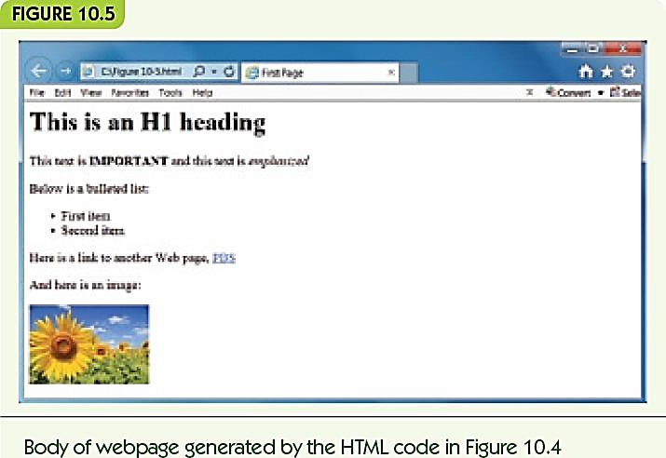
Special-Purpose Languages (5 of 10)

Slide 26
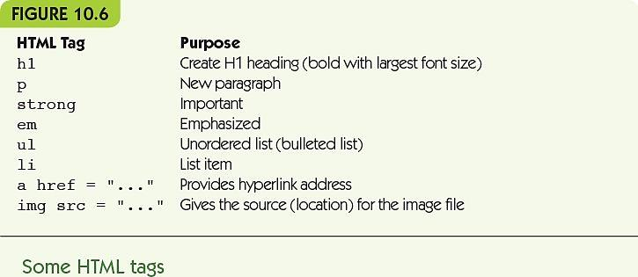
Special-Purpose Languages (6 of 10)

Slide 27
Special-Purpose Languages (7 of 10)
JavaScript
Code embeds in HTML
Enables webpages to react to users
Scripting language
  Interpreted
  Lightweight (reduced features)
Notes:
JavaScript
代码嵌入HTML
使网页能够对用户做出反应
脚本语言
解释
轻量级（减少功能）

Slide 28
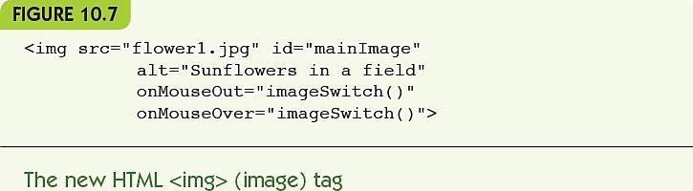
Special-Purpose Languages (8 of 10)
JavaScript example
  Change image when mouse moves over it
  Event handler: a function that responds to an event like mouse movement, button clicks, etc.
Notes:
JavaScript范例
当鼠标移到图像上时更改图像
事件处理程序：响应鼠标移动，按钮单击等事件的函数。

Slide 29
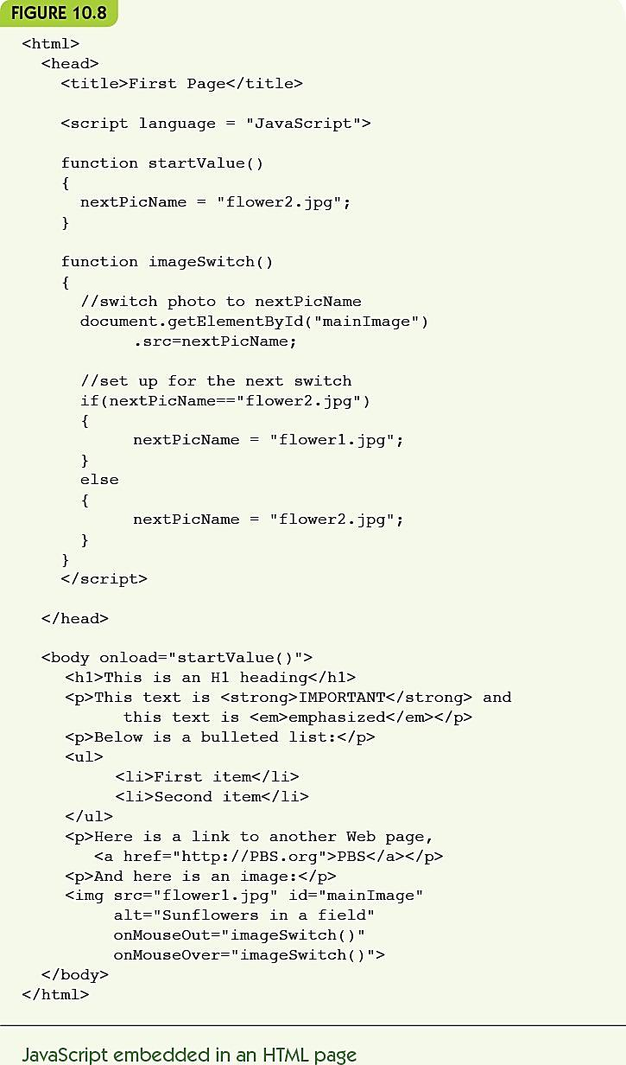
Figure 10.8 JavaScript embedded in an HTML page

Slide 30
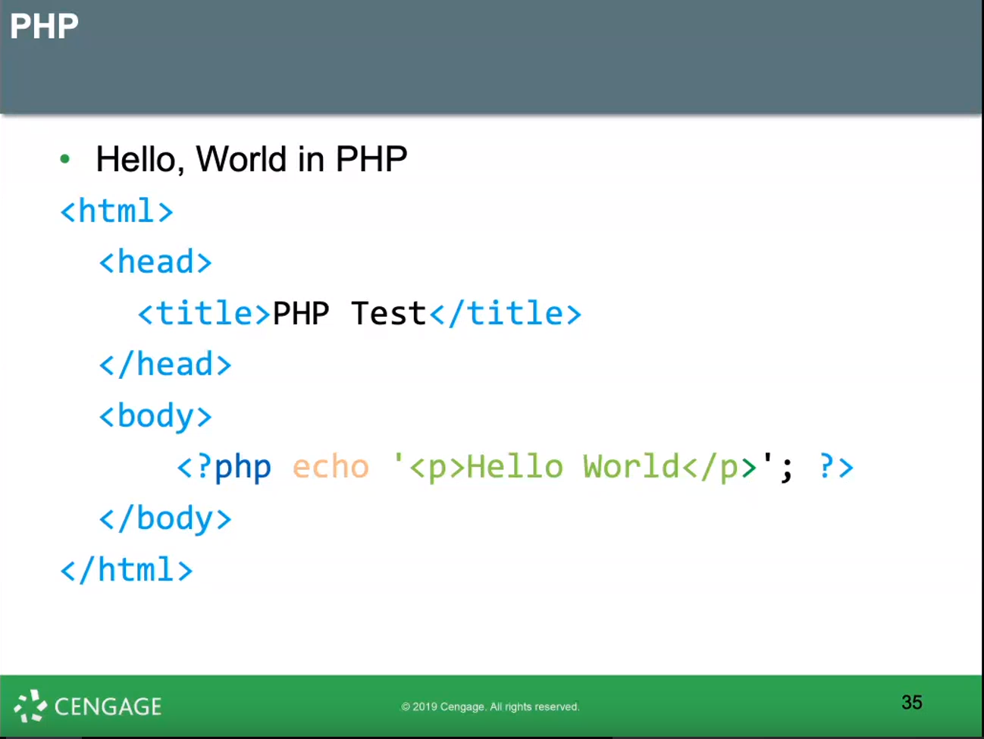
  Interpreted language

Slide 31
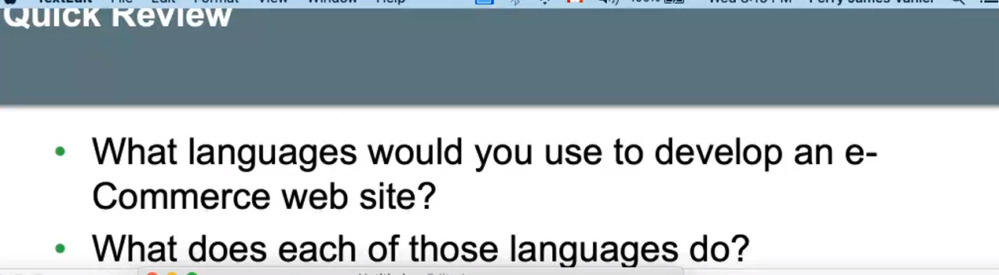
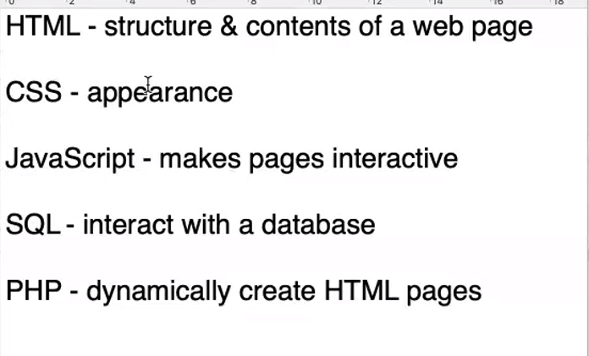

Slide 33
Special-Purpose Languages (9 of 10)
The name “R” comes in part from the first names of the two authors of the language, Ross Ihaka and Robert Gentleman
An open source language, first released in 2000
Given a set of data,
  can compute maximum, minimum, standard deviation, other statistical functions
  Can graphically visualize data sets
Important in Data Science
Notes:
名称“ R”部分来自该语言的两位作者Ross Ihaka和Robert Gentleman的名字
一种开源语言，于2000年首次发布
给定一组数据，
可以计算最大，最小，标准偏差，其他统计函数
可以图形化显示数据集
在数据科学中很重要

Slide 34
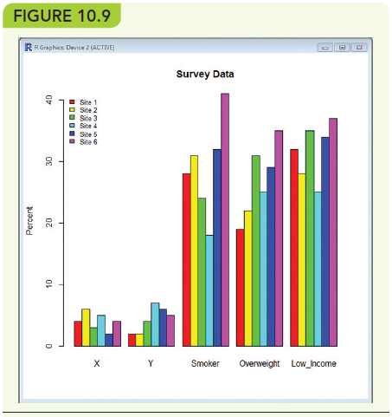
Special-Purpose Languages (10 of 10)
R can produce a colorful bar graph as shown below

Slide 35
Alternative Programming Paradigms (1 of 16)
Paradigm: model or mental framework for thinking about something
Procedural programming paradigm
  A program is a sequence of detailed instructions, accessing and modifying memory locations
Functional programming paradigm
  A program is a series of transformations on items
Notes:
范式：思考问题的模型或思维框架
过程编程范例
程序是一系列详细的指令，用于访问和修改内存位置
函数式编程范例
程序是对项目的一系列转换

Slide 36
Alternative Programming Paradigms (2 of 16)
Logic programming paradigm
  A program is a series of logical deductions from known facts
Parallel programming paradigm
  A program is made up of
    Multiple copies of the same subtask OR
    Multiple subtasks of the same problem
    Performed simultaneously by different processors
Notes:
逻辑编程范例
程序是从已知事实中得出的一系列逻辑推论
并行编程范例
一个程序是由
同一子任务的多个副本，或者
同一问题的多个子任务
由不同的处理器同时执行

Slide 37
Alternative Programming Paradigms (3 of 16)
Functional Programming
  LISP was developed in 1958 at MIT by John McCarthy
  Scheme is a variant of LISP developed in the 1970s
  Functional programming language
    Organized around functions
    A function takes inputs and produces a single value
    Define functions
    Call, or apply, functions
    Combine function calls
  Applicative languages
Notes:
Functional Programming
LISP was developed in 1958 at MIT by John McCarthy
Scheme is a variant of LISP developed in the 1970s
Functional programming language
Organized around functions
A function takes inputs and produces a single value
Define functions
Call, or apply, functions
Combine function calls
Applicative languages

Slide 38
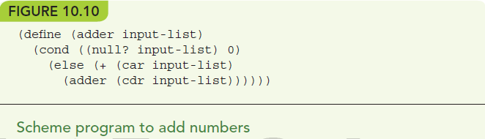
Alternative Programming Paradigms (4 of 16)
Lists: linear collections of data
  (list 5 1 2) = (5 1 2)
  (car (list 5 1 2)) = 5
  (cdr (list 5 1 2)) = (1 2)
  (null (list 5 1 2)) = false
Notes:
Lists: linear collections of data
(list 5 1 2) = (5 1 2)
(car (list 5 1 2)) = 5
(cdr (list 5 1 2)) = (1 2)
(null (list 5 1 2)) = false

Slide 39
Alternative Programming Paradigms (5 of 16)
Example:
(adder (5 10))
= (+ 5 (adder (10))) = 5 + (adder (10))
= 5 + (+ 10 (adder ())) = 5 + 10 + (adder ())
= 5 + 10 + 0 = 15
Recursive: defined in terms of smaller versions of itself
No side effect here: no changes to values outside calculation
Notes:
例：
（加法器（5 10））
=（+ 5（加法器（10）））= 5 +（加法器（10））
= 5 +（+ 10（加法器（）））= 5 + 10 +（加法器（））
= 5 + 10 + 0 = 15
递归：根据自身的较小版本定义
在这里没有副作用：计算外的值没有变化

Slide 40
Alternative Programming Paradigms (6 of 16)
Logic programming languages
Programs describe rules and facts, not how to do something
Queries use logical deduction to produce outputs that follow from the rules and facts given
Declarative programming languages
  Programs declare what is true
Artificial intelligence applications
  Expert systems solve problems with logical reasoning
Notes:
逻辑编程语言
程序描述规则和事实，而不是如何做某事
查询使用逻辑推论来产生遵循给定规则和事实的输出
声明式编程语言
程序声明什么是正确的
人工智能应用
专家系统通过逻辑推理解决问题

Slide 41
Alternative Programming Paradigms (7 of 16)
Prolog was developed in 1972 at the University of Marseilles by A. Colmerauer
Facts describe relationships among specific objects
  president(nixon, vietnam_war).
Rules describe general relationships using variables
  precedes(X, Y) :- before(X, Y).
    X precedes Y if X came before Y
  precedes(X, Y) :- before(X, Z), precedes(Z, Y).
    X precedes Y if X came before Z and Z precedes Y
Notes:
Prolog由A. Colmerauer在1972年于马赛大学开发
事实描述特定对象之间的关系
总统（尼克松，越战）。
规则使用变量描述一般关系
befores（X，Y）：-before（X，Y）。
如果X在Y之前，则X在Y之前
befores（X，Y）：-before（X，Z），befores（Z，Y）。
如果X在Z之前并且X在Y之前，则X在Y之前

Slide 42
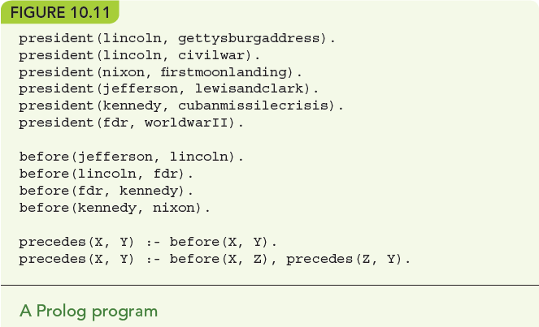
Alternative Programming Paradigms (8 of 16)

Slide 43
Alternative Programming Paradigms (9 of 16)
Programming in Prolog
Programmer builds a knowledge base of facts and rules
To “run” a program, pose queries to the inference engine, deductive algorithm is provided in Prolog
Results to the query come back from Prolog
Example of deductive reasoning using fixed rules
  Modus ponens: if we know the rule “If A then B” and we know A is true, then we deduce that B is true
Notes:
在Prolog中编程
程序员建立事实和规则的知识库
要“运行”程序，向推理引擎提出查询，Prolog中提供了演绎算法
查询结果从Prolog返回
使用固定规则的演绎推理示例
方法：如果我们知道规则“如果A那么B”，并且我们知道A为真，那么我们就可以推论B为真

Slide 44
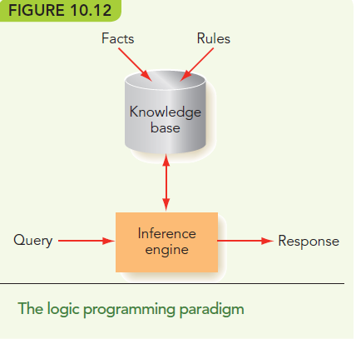
Alternative Programming Paradigms (10 of 16)

Slide 45
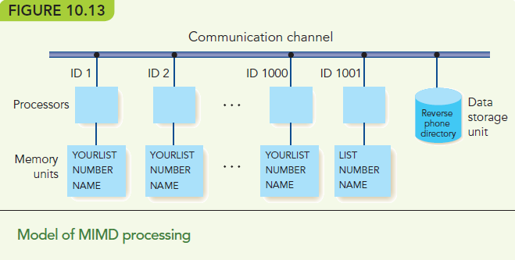
Alternative Programming Paradigms (11 of 16)
Parallel programming is required for large-scale computing problems

Slide 46
Alternative Programming Paradigms (12 of 16)
MIMD: multiple instruction, multiple data
  Many CPUs, each operates on its own data
  Multicore computing
    Multiple processors on one chip
  Cluster computing
    Processors may be heterogeneous
    Connected by a LAN or WAN
Notes:
MIMD：多指令，多数据
许多CPU，每个CPU都使用自己的数据
多核计算
一块芯片上有多个处理器
集群计算
处理器可能是异构的
通过局域网或广域网连接

Slide 47
Alternative Programming Paradigms (14 of 16)
MIMD example: search for a name in a NYC phonebook
101 processors
Processor 101 handles input/output
  Divide data and tell processors what to search
  Wait for result from some processor
  Output result
Processors 1 to 100 search their portion of data
Notes:
MIMD示例：在纽约市电话簿中搜索名称
101个处理器
处理器101处理输入/输出
划分数据并告诉处理器要搜索的内容
等待来自某个处理器的结果
输出结果
处理器1到100搜索他们的数据部分

Slide 48
Alternative Programming Paradigms (15 of 16)
MIMD better example: find largest number in a list
Divide-and-conquer: split problem into smaller pieces and send to other processors
Top processor divides data in two, sends to two child processors
Repeat until processors have one piece of data
Children send parent their largest value
Parent compares two largest and returns the bigger to its parent
Notes:
MIMD更好的例子：在列表中找到最大的数字
分而治之：将问题分成更小的部分并发送给其他处理器
顶级处理器将数据一分为二，发送给两个子处理器
重复执行直到处理器获得一份数据
孩子们给父母最大的价值
父级比较两个最大的父级，然后将较大的返回给父级

Slide 49
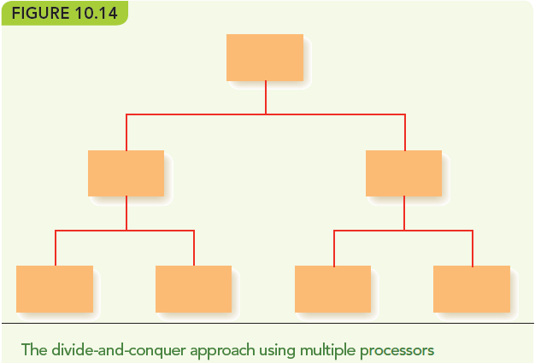
Alternative Programming Paradigms (16 of 16)

Slide 50
New Languages Keep Coming (1 of 3)
Go was developed in 2009 at Google by Ken Thompson
  Combines ease of programming with safety
  Supports networked and multicore computing
  Fast compilation, open source
Swift: new Apple language for building apps in iOS and macOS
Notes:
Go由Ken Thompson于2009年在Google开发。
结合轻松编程和安全性
支持网络和多核计算
快速编译，开源
Swift：用于在iOS和macOS中构建应用程序的新Apple语言

Slide 51
New Languages Keep Coming (2 of 3)
Milk was announced in September of 2016 by MIT’s Computer Science and Artificial Intelligence Laboratory
  Geared toward “big data”
  Focused on using cache memory on multicore processors to speed up the process of accessing data
  Speeds up programs 3 to 4 times

Slide 52
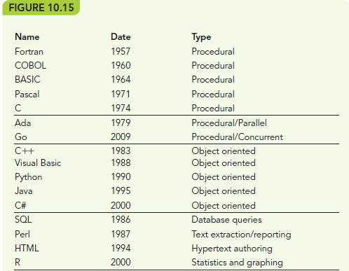
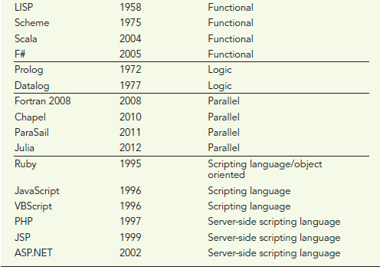
New Languages Keep Coming (3 of 3)

Slide 53
Conclusion
Languages vary by
  Philosophy
  Intended application areas
  Strengths and purposes
  Style, syntax, and semantics
  Approaches to types, variables, and memory
  Tools provided or accessible
Languages cross paradigms
Notes:
语言因
哲学
预期的应用领域
优点和目的
样式，语法和语义
类型，变量和内存的方法
提供或可访问的工具
语言跨范式

Slide 54
Summary (1 of 2)
Many programming languages exist because they reflect different intended uses or different philosophical views.
Procedural programming languages include
  Plankalkül, Fortran, COBOL, C/C++, Ada, Java, Python, and C#.
Special-purpose programming languages have limited range of use: SQL, HTML, JavaScript and R.
Other paradigms include
  Functional, logic, and parallel programming.
Notes:
存在许多编程语言是因为它们反映了不同的预期用途或不同的哲学观点。
过程编程语言包括
Plankalkül，Fortran，COBOL，C / C ++，Ada，Java，Python和C＃。
专用编程语言的使用范围有限：SQL，HTML，JavaScript和R。
其他范式包括
功能，逻辑和并行编程。

Slide 55
Summary (2 of 2)
Functional programming languages organize programs around functions, function calls, and combining of functions.
Logic programming languages do not specify how to do something but give facts and rules and let the program deduce the results.
Parallel programming languages support MIMD parallel processing.
New programming languages evolve continuously for new or evolving purposes.
Notes:
函数式编程语言围绕函数，函数调用和函数组合来组织程序。
逻辑编程语言没有指定如何执行操作，而是给出了事实和规则，并让程序推断出结果。
并行编程语言支持MIMD并行处理。
新的编程语言出于新的或不断发展的目的而不断发展。

